Slide 1

TEAM Rose&Jack
Isabelle Kluser
Andreas Palm
Reto Stucki
05.11.2018

Slide 2
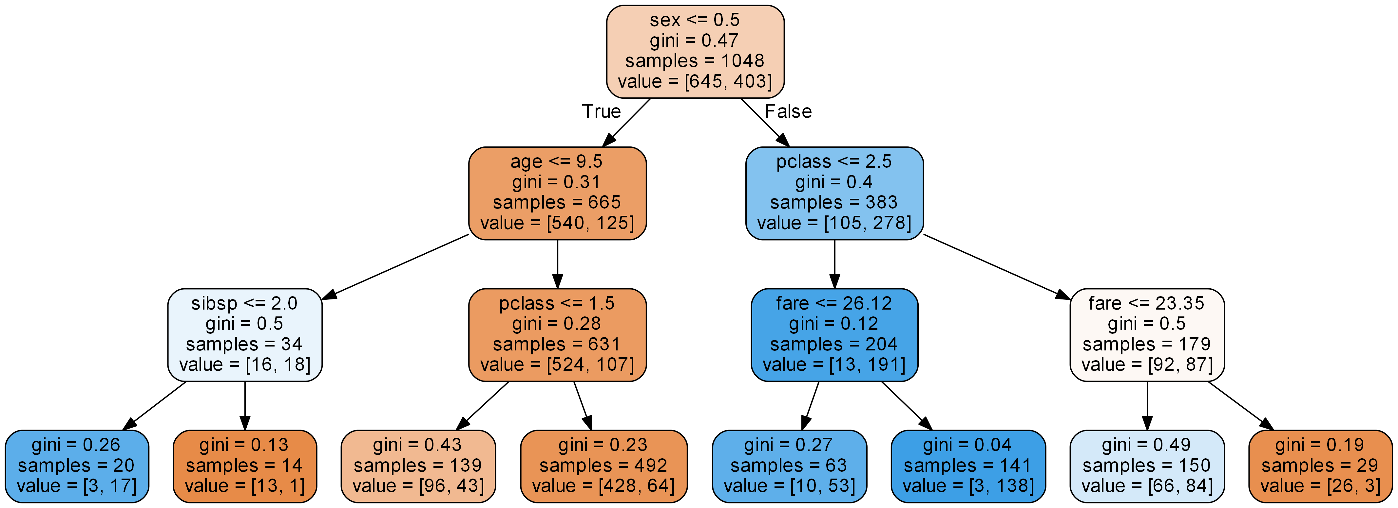
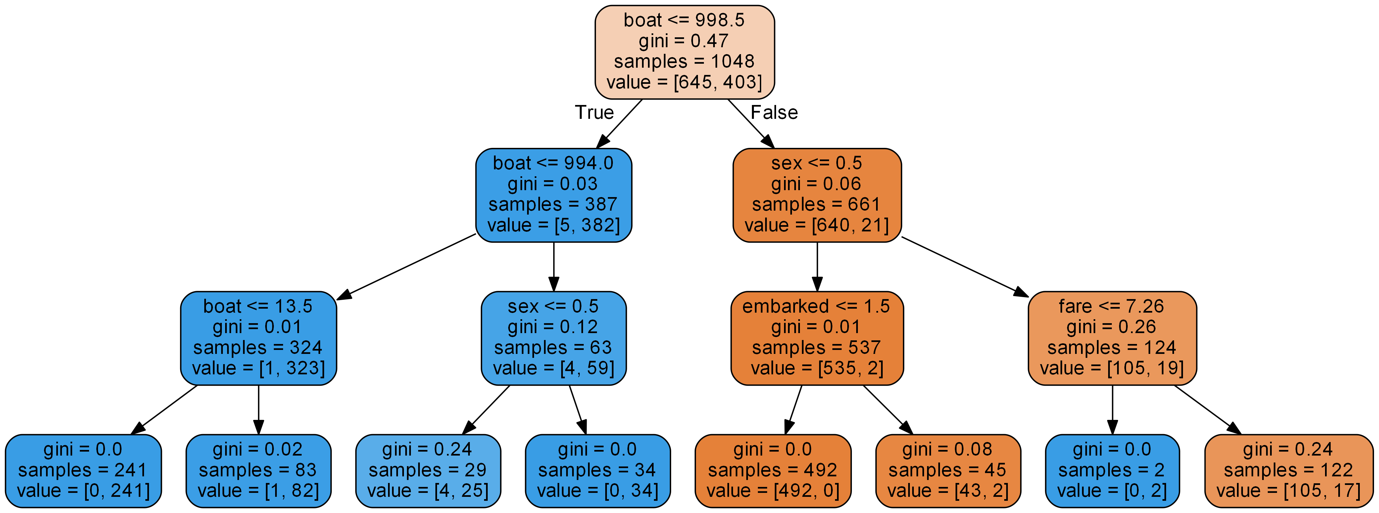
Rose&Jack Pre vs Post
pre
0.82
post
0.97
Notes:
1. Slide: Compare the two results (on the leaderboard) and the underlying approaches
• 2.• 3. Slide: Partner A reports on his findings in B’s or C‘s code and ...
• ...relates it to what he/she has learned during this course
• and vice-versa

Slide 3
Rose&Jack Technology
Notes:
Slide: Technological uniqueness

Slide 4
Rose&Jack Learnings
Notes:
- Decision Tree Depth is relevant (7 vs. 3), danger of over engineering

